Slide 1
Satellite Command System Programming Exercise

Slide 2
Problem Statement
Objective: Develop a Satellite Command System for simulating satellite control in orbit.
Requirements:
Initialize satellite
Rotate
Activate/Deactivate Solar Panels
Collect Data
Initial State:
Orientation: "North"
Solar Panels: "Inactive"
Data Collected: 0

Slide 3
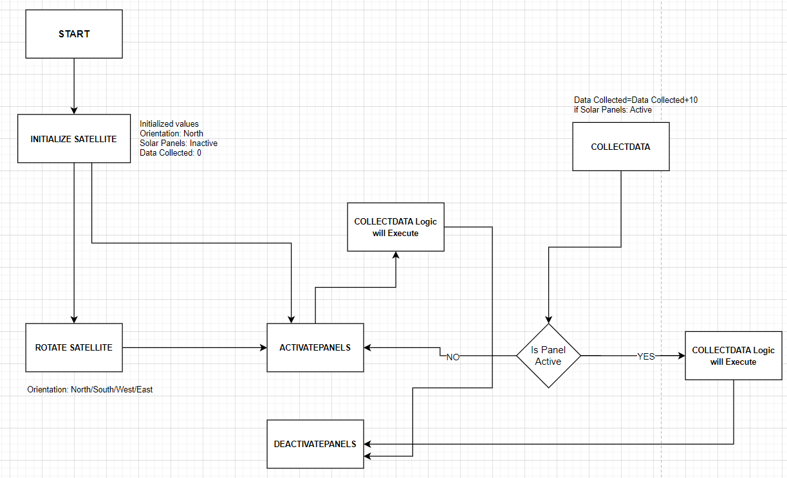
Design(Approach 1)

Slide 4
Design
Command Pattern:
Organizes commands as objects.
Components:
Commands: Rotate, Activate Panels, Collect Data, Deactivate.
Receiver: Satellite class manages actions.
Invoker: Initiates and handles command execution.
State Management:
Satellite class maintains its state. Commands update state.
Error Handling & Logging:
Graceful error handling with retries.
Logging for event tracking and errors.

Slide 5
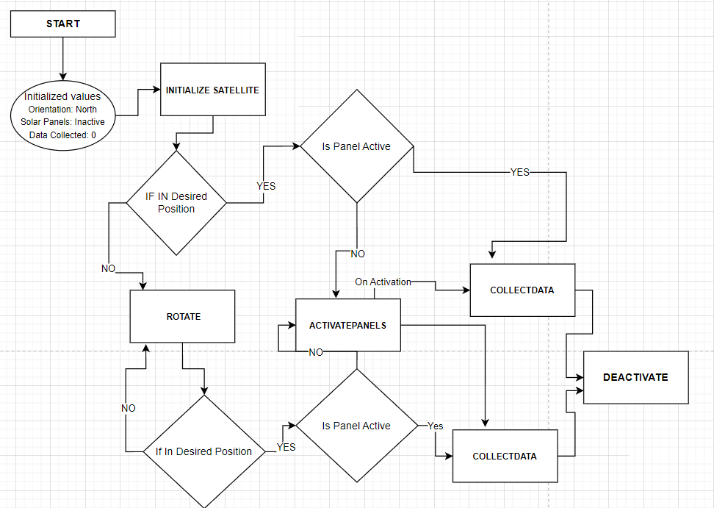
Design (Approach 2)

Slide 6

Discussion points
What if the satellite is already in desired position?
Avoid unnecessary rotations we can add a check in ‘collectDatacommand’ to verify if current orientation is desired one.
If not in desired position rotate it and check if panel is active
else check the panel status and proceed with the further commands.
What if command fail temporarily due to external factors?
Defensive programming: If an exception occurs during the execution of the command, the system will attempt to retry the operation for a certain number of times before giving up.

Slide 7
THANK YOU

